Slide 1
Volatility
Forecasting market volatility for a safer public welfare environment.
Andrei Matveev, Department of Mathematical and Statistical Sciences, University of Colorado Denver
Notes:
Hi everyone. I’m glad to see you are interested in the method I covered within my project.
I will be talking about AdaBoost.

Slide 2
Volatility
Forecasting market volatility for a safer public welfare environment.
Content:
Introduction
Market volatility overview
Question of interest
Case study
Data set
Models
Results
Conclusions
Notes:
Based on the results of this project I believe it is possible to use Bayesian modelling framework for time series forecasting (although this work did not provide a tool to address the question of interest). I found that this field of research has a lot of challenges which are not visible from the beginning for a newcomer and at the same time is interesting and promises valuable practical results. The most surprising result for me was how sensitive complicated models (i.e. Realized GARCH) are to prior selection – they just do not run with non-relevant low-informative priors. The project also helped me to build better intuition for posterior predictive check and greatly improve my knowledge of STAN language. Additionally, I found an interesting area for my further research related to implementation of Bayesian framework for n-days-ahead time series forecasting, which would let me improve the design of this study. In addition, working on this project I became interested in multivariate GARCH models.

Slide 3
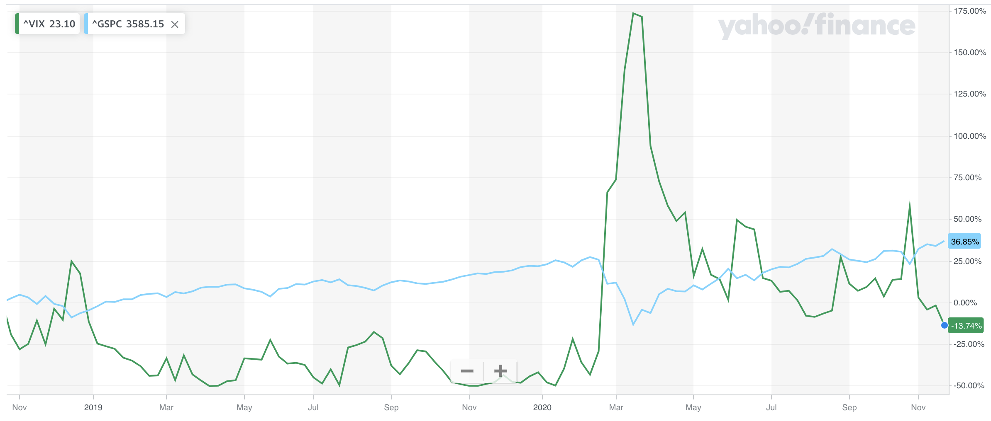
Market volatility overview
U.S. stock market
individual investors share: 19.5%
YTY share growth : 14.9%
10 years growth: ~100%
55% of Americans own stock
Investors lose money
when volatility is high
Figure 1. S&P500 (blue line) vs. volatility index (VIX, green line)
Notes:
According to Bloomberg Intelligence During the first six months of this year individual investors accounted for almost 20% of the shares traded in the U.S stock market, up from 14.9% last year and nearly doubled the level from 2010.
Gallup finds 55% of Americans reporting that they own stock, based on polls conducted in March and April 2020
One of the major risks investors face is the stock market volatility, which is exceptionally high this year.
Traditionally volatility is measured by VIX index which is remarkable because is calculated from financial derivative prices and thus reflects current market expectation about the future volatility.
Figure 1 on this slide shows that VIX has a strong negative correlation with S&P500 index.
Therefore, volatility forecasts appeared to be very important for Public Good as it may help a lot of people, especially newcomers to the stock market, to avoid substantial financial operations during periods of high volatility.

Slide 4
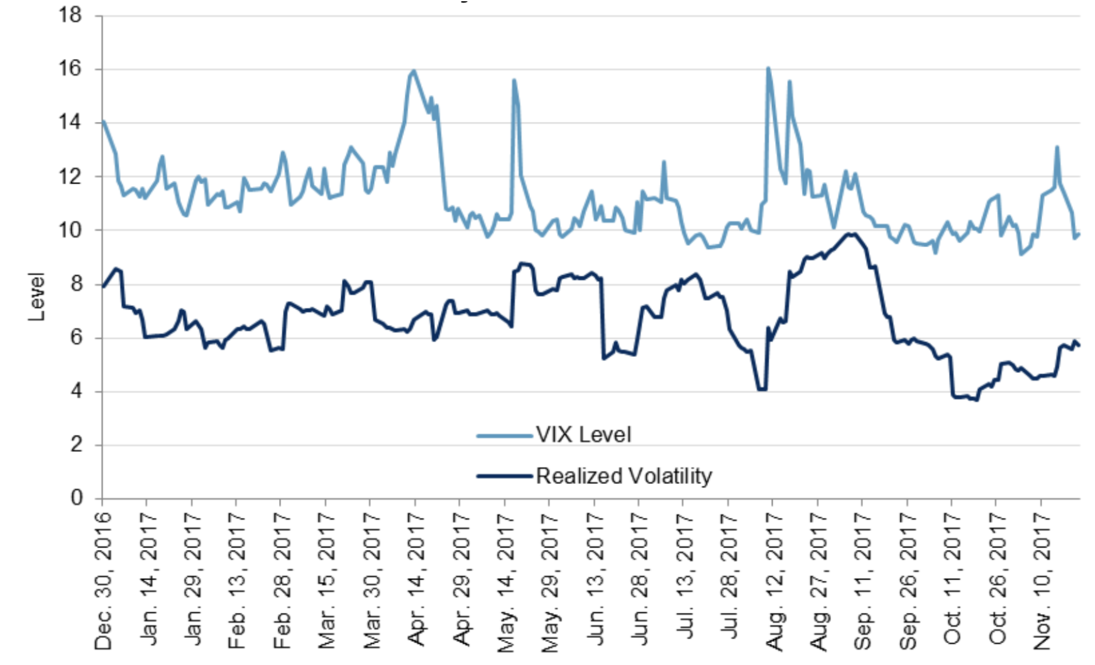
Question of interest
VIX vs S&P500
Realized volatility differs from VIX
The gap can also be negative
Investors can not rely on current levels of VIX
Question of interest
“Is the expected market volatility acceptable for me to make investment decisions during this time?”.
Figure 2. VIX vs realized S&P 500 volatility
(Source: S&P Dow Jones Indices LLC and CBOE)
Notes:
One of the natural choices for volatility forecasting is VIX itself which is inherently forward-looking. But the difficulty is that VIX substantially differs from the realized volatility measured by the actual S&P 500 performance, where the former averaging more than four points higher than actual realized volatility (Figure 2).
To help individual investors to avoid trading during unacceptably volatile periods it is reasonable to try to find a way of future volatility forecasting. Using this forecast one will be able to answer the following question: “is the expected market volatility acceptable for me to make investment decisions during this time?”.

Slide 5
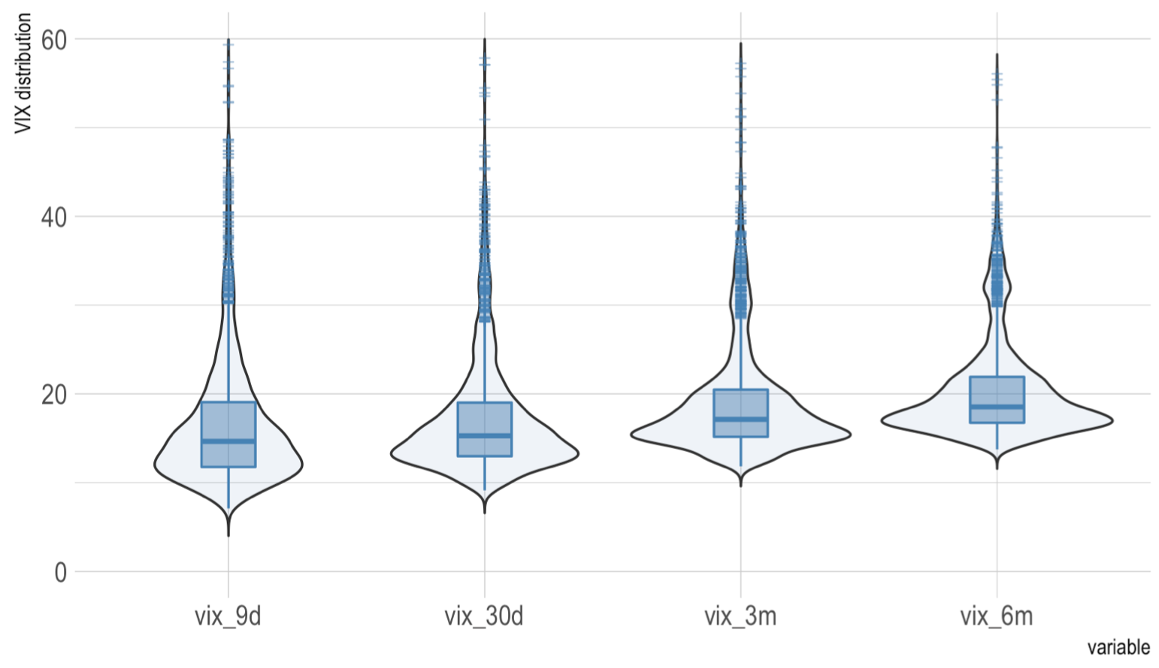
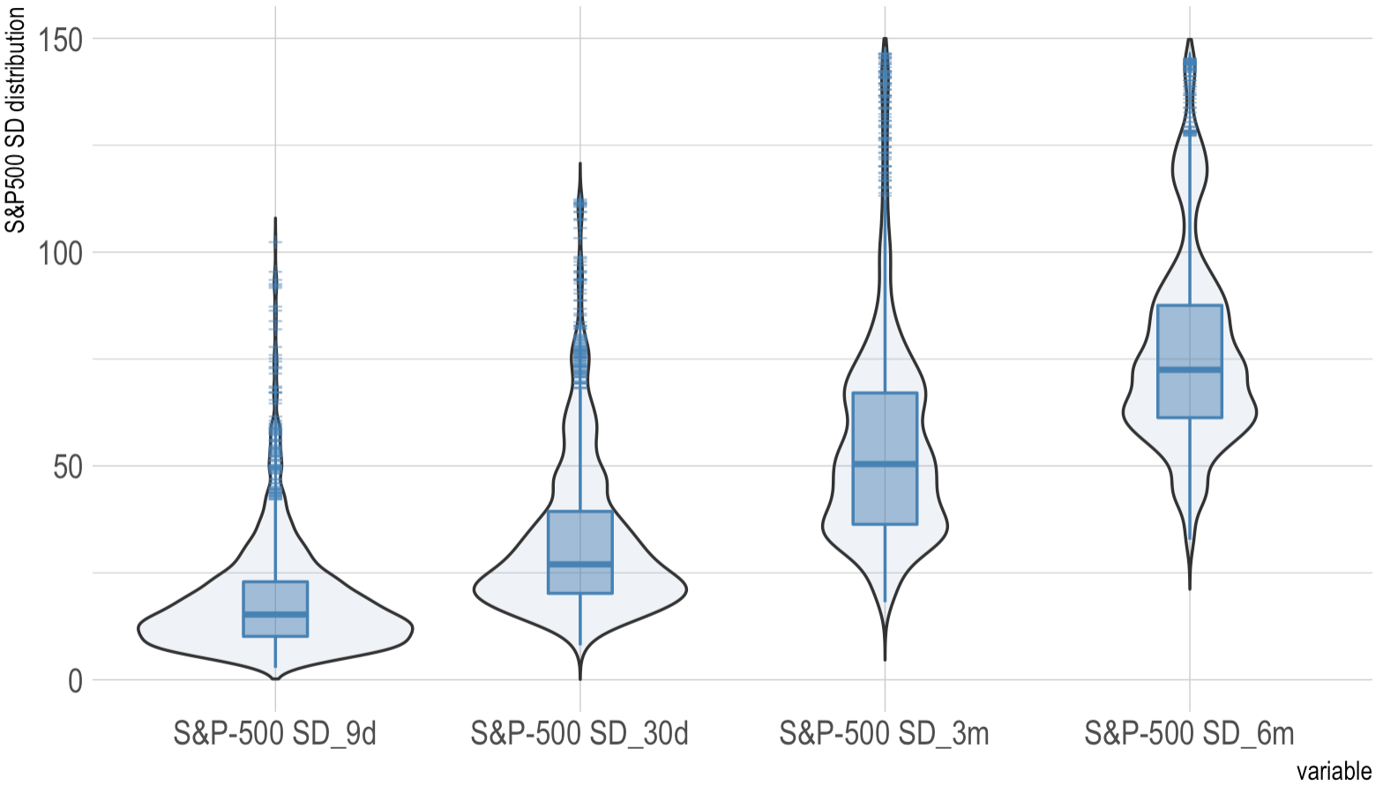
Data set
Figure 3. VIX distribution
(the last 10 years)
Figure 4. S&P-500 standard deviation
(different time windows)
Notes:
For exploratory data analysis I combined into one dataset data for VIX, realized volatility and S&P500 and their derivatives (namely standard deviation with different time shift).
S&P500 quotes YAHOO;
VIX quotes - provided by the Chicago Board Options Exchange (CBOE) - the largest U.S. options exchange;
realized volatility estimates - provided by the Oxford-Man Institute's "realized library"
There are 4 VIX indexes calculated for different time windows (figure 3). Based on the lengths of these windows I calculated the coreespondend SD deviations for SP500 and…

Slide 6
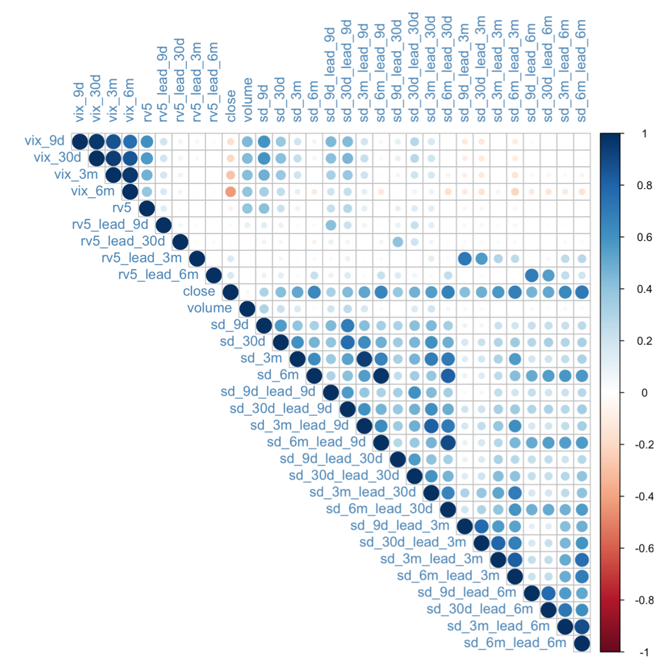
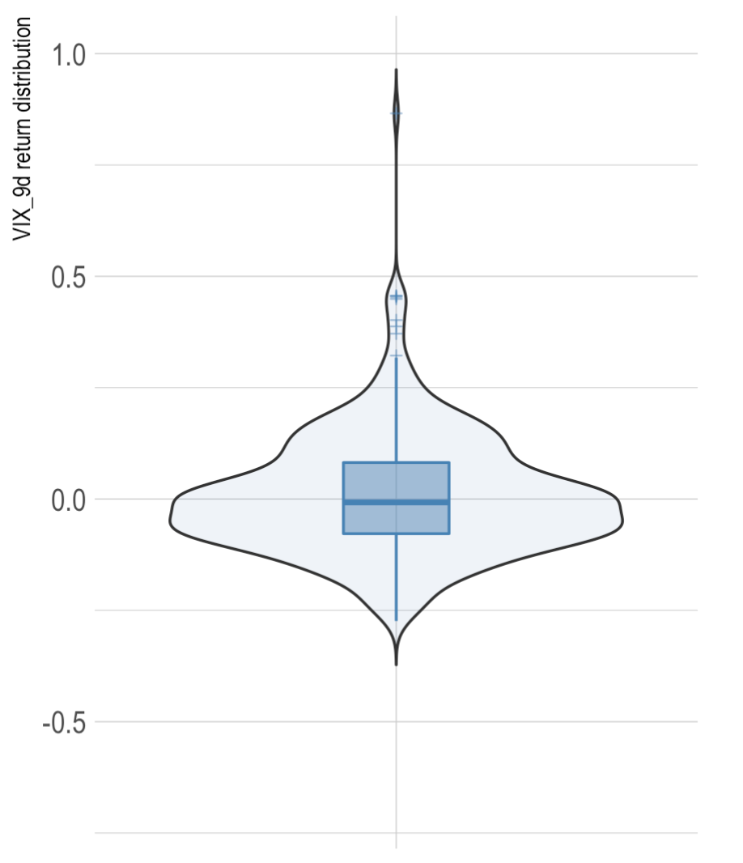
Data set
Can be an indicator
for some predictive
power of VIX_9d
Figure 3. VIX correlation
Figure 4. VIX_9d returns
distribution
Notes:
…also added shifted forward SD time series with the same forming a bunch of SP500 derivative time series.
As the starting point to the question of this project, I examined correlation between all these variables. Interestingly enough, there is almost no correlation between VIX indexes and future point estimates of realized volatility which implies that we VIX is not a good estimate for realized volatility with corresponding time lag. At the same time there is quite a strong correlation between VIX_9d and standard deviations of S&P500 9 days from now (sd_9d_lead_9d). In addition, VIX_9d is highly correlated with the current realized volatility (Figure 6). It let me narrow down the question of this project to “is the expected VIX_9d dynamic acceptable for me to make investment decisions during the next 9 days?” and focuses my further research to modelling of returns of VIX_9d time series.

Slide 7
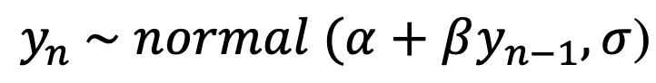


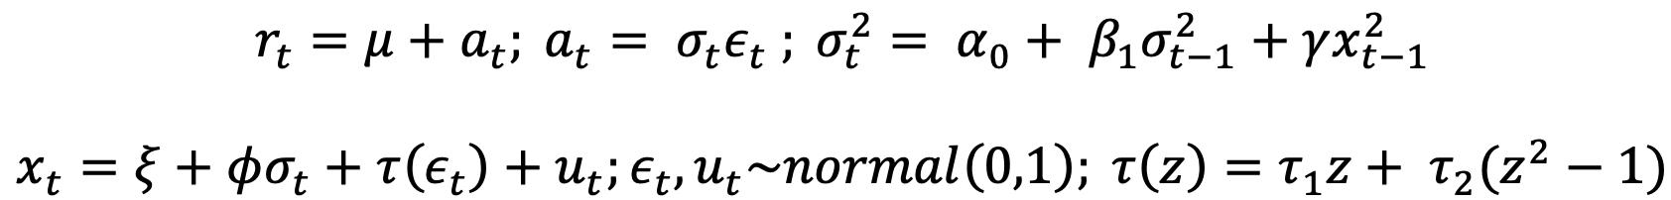
Models
1. A first-order autoregressive model, AR(1)
2. Autoregressive conditional heteroscedasticity model, ARCH(1)
3. The generalized autoregressive conditional heteroscedasticity model, GARCH(1,1)
4. The Realized GARCH model, Realized GARCH(1,1)
Notes:
A first-order autoregressive model AR(1) with normal noise takes each point y_n in a sequence y to be generated according to …
Autoregressive conditional heteroscedasticity model (ARCH(1)) Engle 1982 takes the scale of the noise terms to vary over time and leaves the mean term fixed
In the GARCH(1,1) extends the ARCH(1) model by including the squared previous difference in return from the mean at time t-1 as a predictor of volatility at time t.
In the Realized GARCH framework, sigma is also dependent on the lagged realized measure of volatility, such as the realized daily variance.

Slide 8
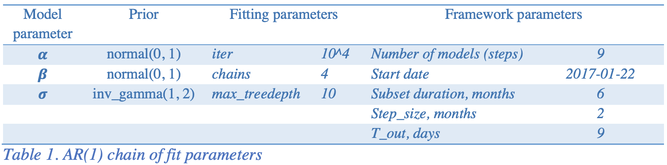
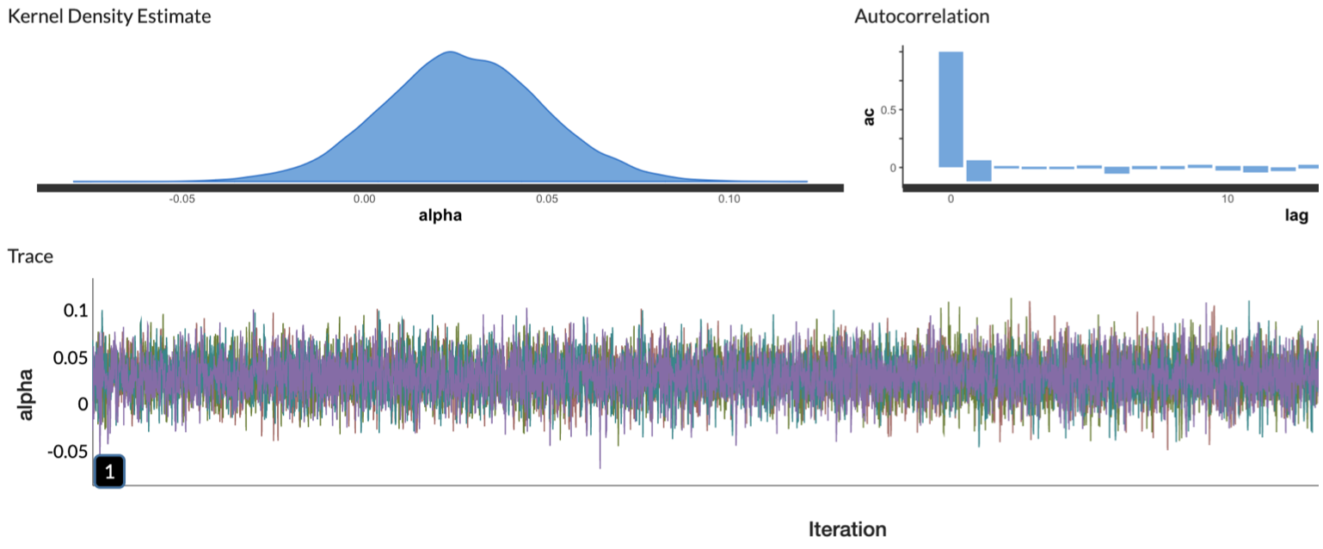
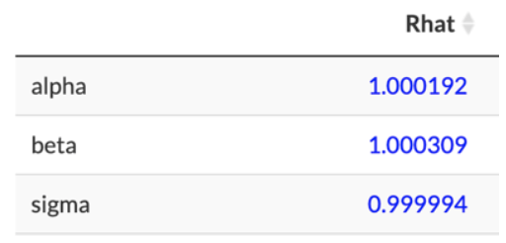
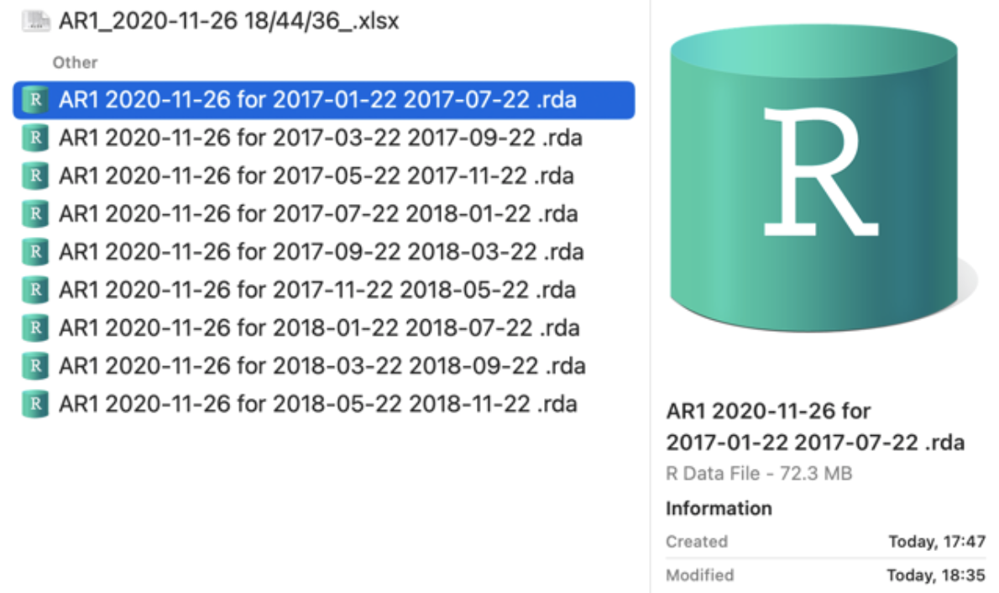
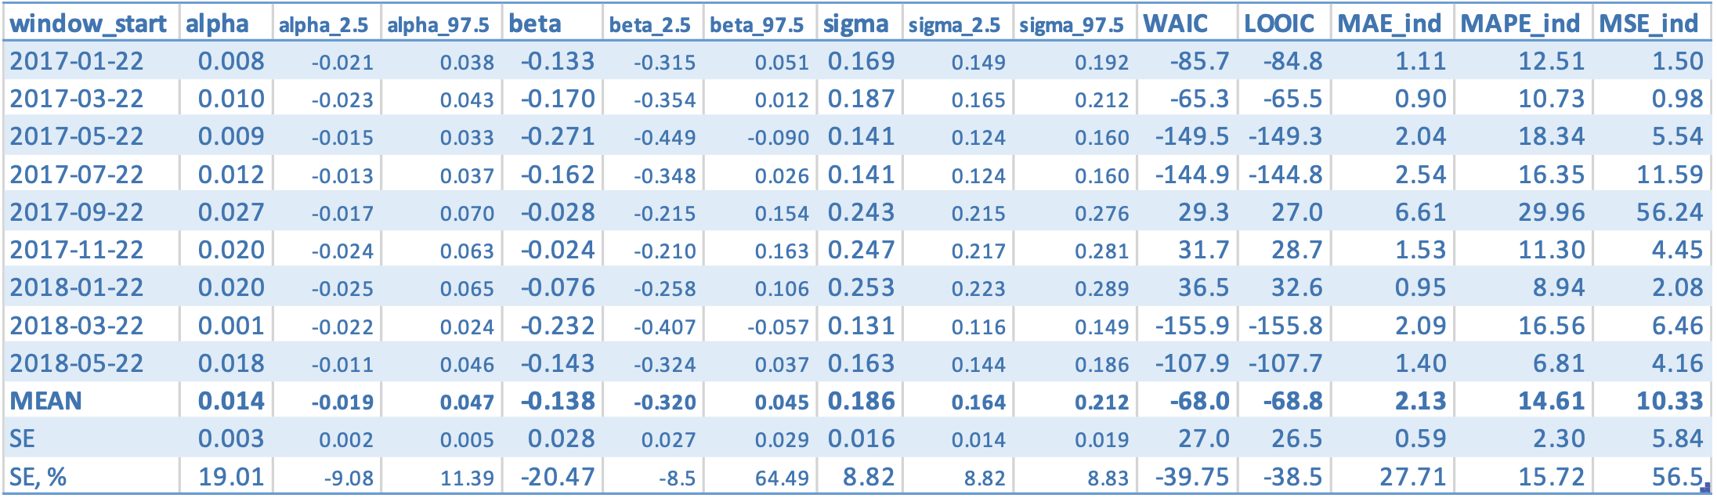
Model 1 - AR(1)
Notes:
Created the model (using low-informative priors derived from the actual data distribution)
Build it (SHOW) for 6-months time window (10^4 4 chains),
Recorded the results
Moved the time window by 2 months
Repeated the process 9 times (saving the modeling results SHOW)
Found the means and errors of all the parameters and metrics calculated
Checked the convergence (That, trace, autocorrelation)

Slide 9
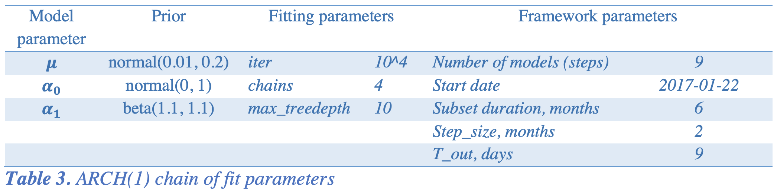
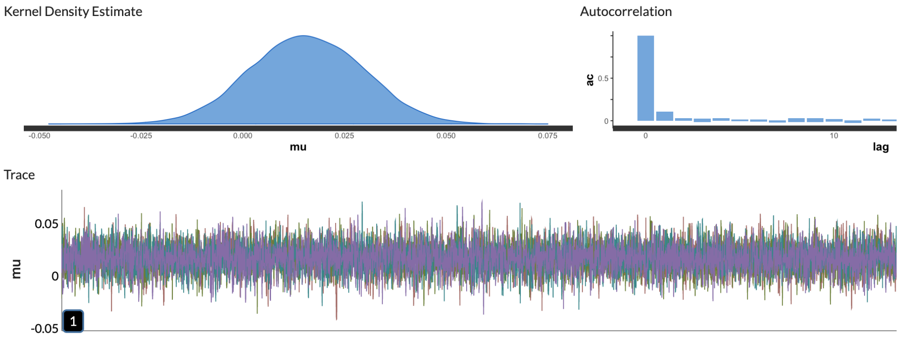
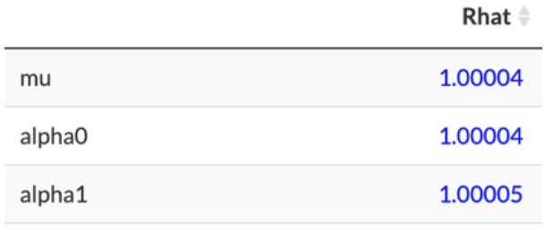
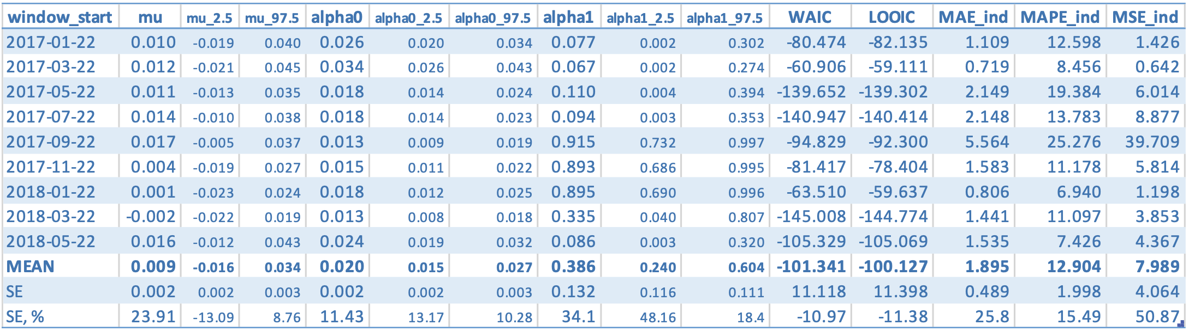
Model 1 - ARCH(1)
Notes:
Successfully repeated this process for ARCH model

Slide 10
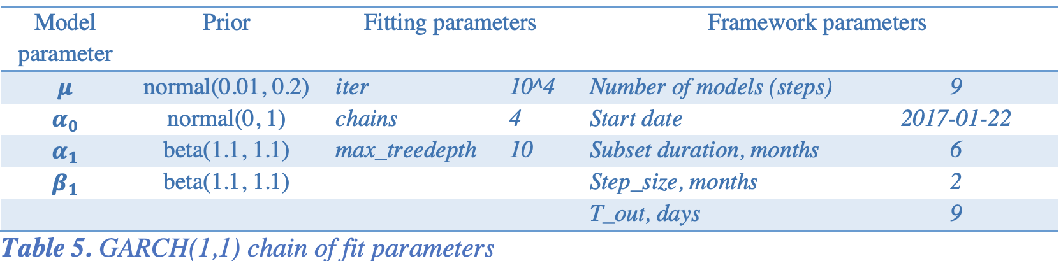
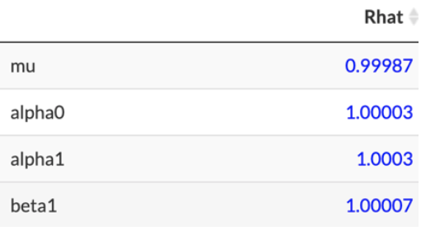
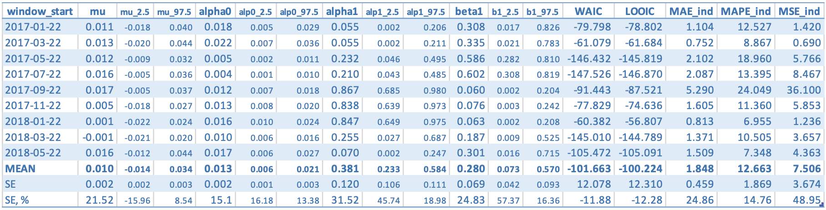
Model 1 - GARCH(1)
Notes:
And for GARCH model (also achiving convergence and using the same approach to forming low informative priors)

Slide 11
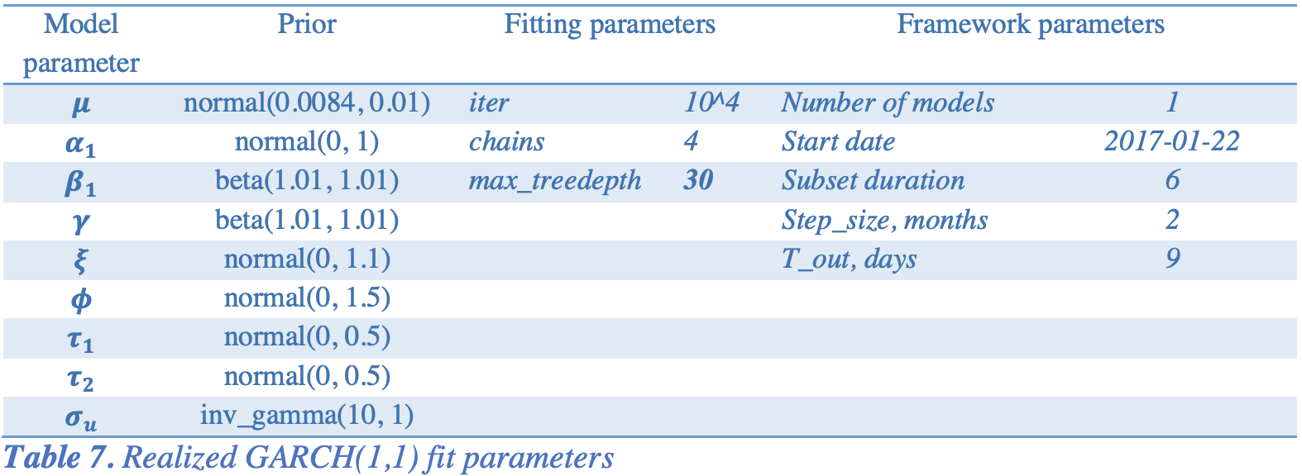
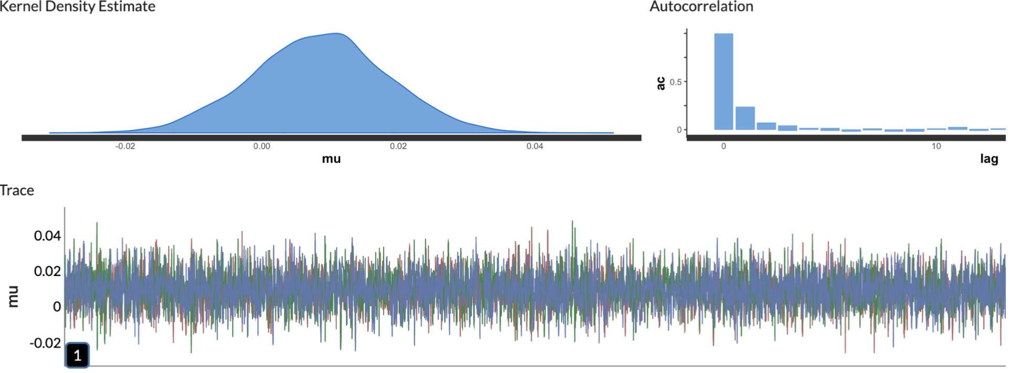
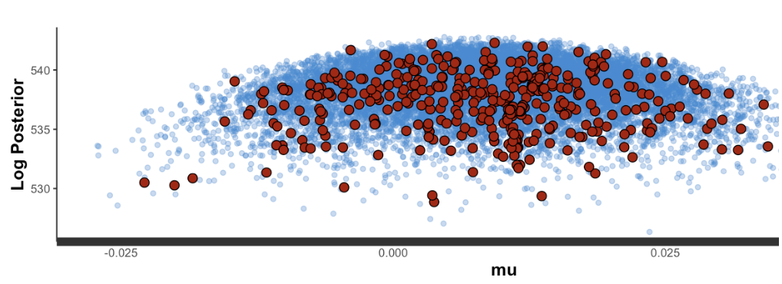
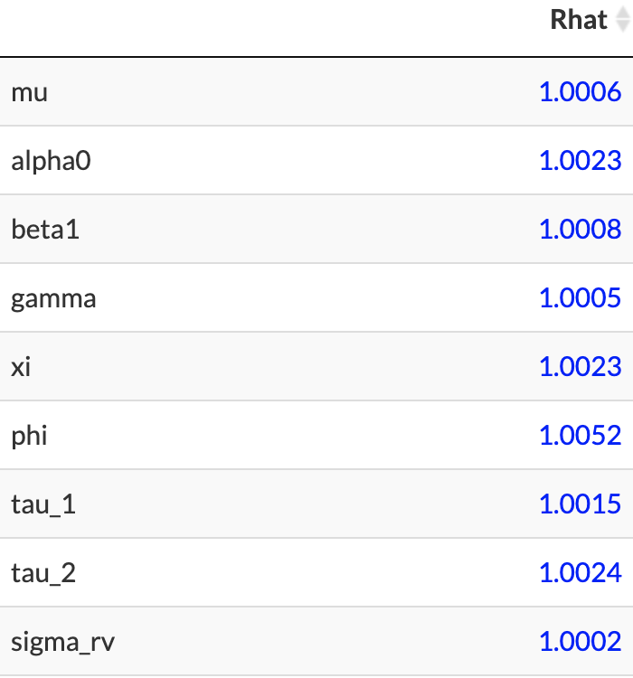
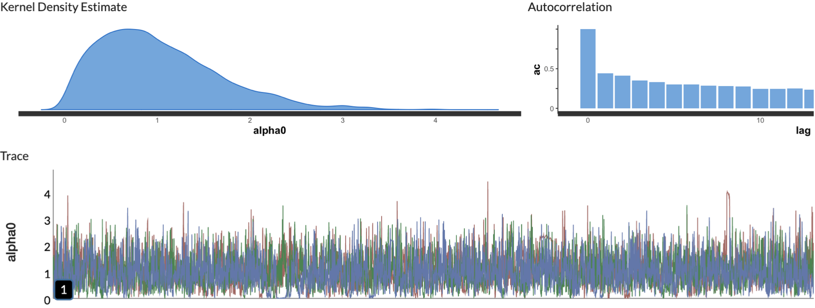
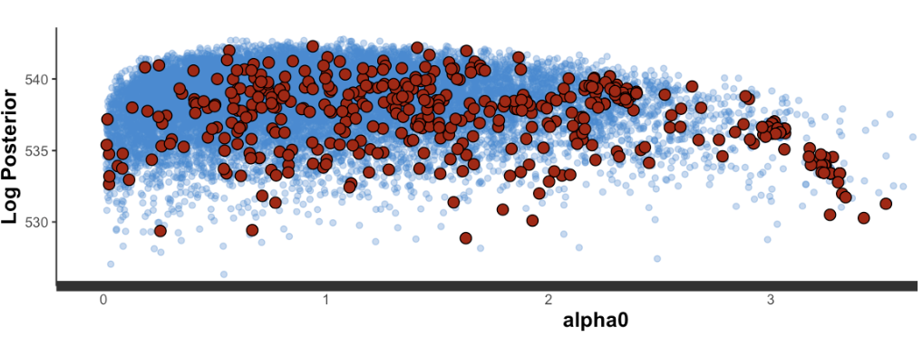
Model 1 - Realized GARCH(1)
Signs of divergence from STAN
(large red points indicate
which iterations encountered a divergent transition)
Notes:
But for Realized GARCH model (though achiving good convergence results for most of parameters)
And having Rhat very close to one for all the parameters,
I got autocorrelation for 1/3 of parameters and also indication of divergence by the STAN software
I spent a lot of time working with different priors (especially for sigma u) which constantly improved the results,
But at the end did not get a fully converging version
Thus decided not to use this Model.

Slide 12
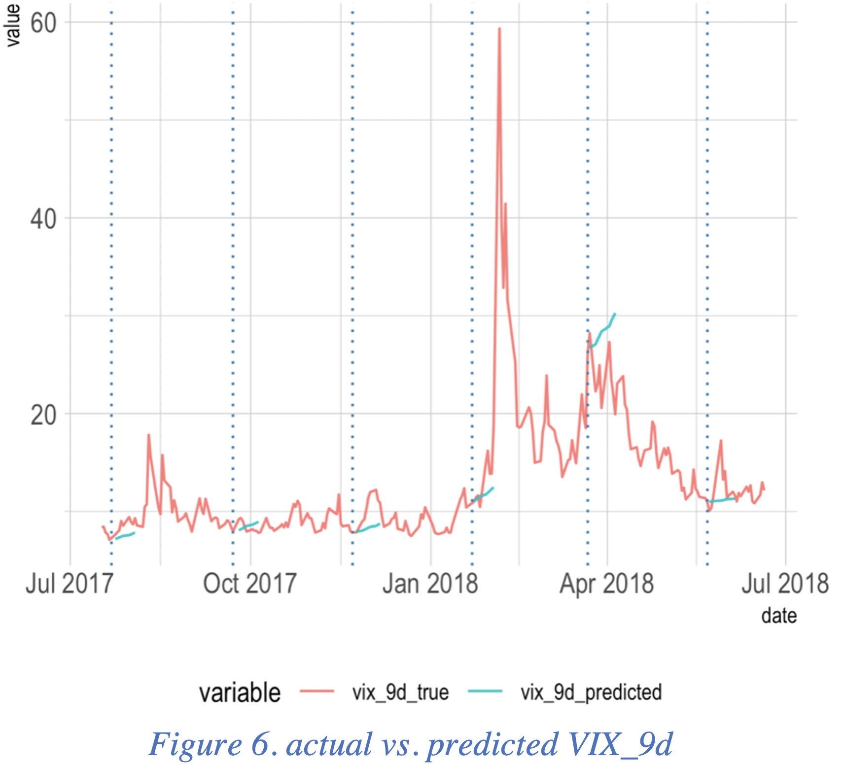
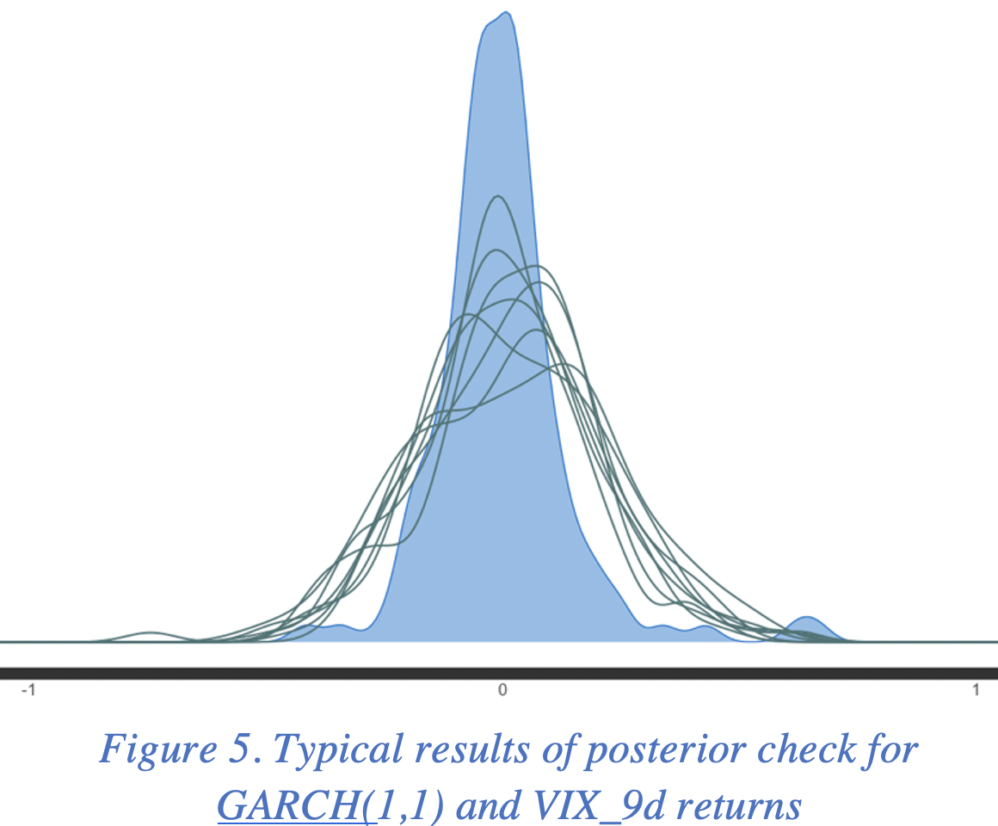
Results
Based on the lowest WAIC/ LOOIC, stability and MSE, GARCH(1,1) is the best choice model in this project
9 days predicted results are skewed towards increasing 9 days series (i.e. with positive returns) and do not fit the actual data.
A more sophisticated data reconstruction algorithm (i.e. from returns distribution to index value) is required.
Notes:
ARCH(1) and GARCH(1,1) on average had very close WAIC/ LOOIC, but at the same time out of sample results for GARCH(1,1) were better (i.e. smaller errors for 9 days forward prediction; e.g. MSE GARCH(1,1) 7.506 vs MSE ARCH(1) 7.989).
Distributions of observed data and a random sample of replications (Figure 5) shows that distribution of the real data is narrower and left-shifted in comparison with the distribution of samples drawn from the posterior distribution. This might suggest that the GARCH(1,1) model with parameters found in this project is not the best one for real-life prediction.
9 days predicted results for every time window (dotted vertical lines are at the end of these overlapping windows) also confirms this outcome. The results are skewed towards increasing 9 days series (i.e. with positive returns) and do not fit the actual data. It implies that usage of posterior mean returns for reconstruction of the time series (based on starting points and chain of mean returns) is not an optimal way for such kind of problems and should be replaced by a more sophisticated data reconstruction algorithm.

Slide 13
Conclusions
Bayesian modeling framework can be used for time series forecasting
Challenging and promising field of research;
Advanced time series models are very sensitive to prior selection;
The project helped:
to build intuition for posterior predictive check;
to improve knowledge of STAN language;
The framework created within this project will provide a tool to address the question of interest after additional research in the following areas:
Bayesian n-days-ahead time series forecasting;
multivariate GARCH models.

Slide 14
References

